Slide 1
Microsoft Search The what, the why and the how
Kevin McDonnell
Solutions Architect, CPS
M365 UK User Group – Feb 2021
Notes:
Hello and welcome to this session that is covering Microsoft Search – the what, the why and the how. I hope that you are enjoying the talks so far and hope that I can teach you about how Microsoft Search can help you and how can extend it for your own needs. But first, a little about me.

Slide 2

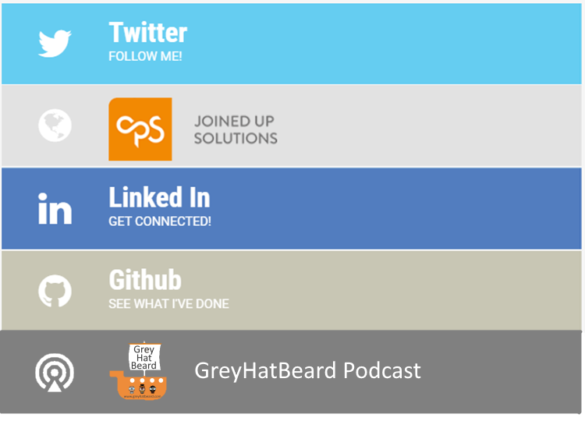

Kevin McDonnell
Solutions Architect - CPS
https://www.mcd79.com
@kevmcdonk
www.cps.co.uk
/kevmcdonnell
/kevmcdonk
Notes:
I am a Solutions Architect at CPS, a Microsoft Gold Partner based in the UK, where I focus on Modern Workplace which includes Office 365/SharePoint.Teams and that sort of thing and also do a decent amount of Azure focused development. I blog at www.mcd79.com and I’m a co-host along with Al Eardley and Garry Trinder for the GreyHatBeard podcast which you can find at greyhatbeard.com or on Apple Store, Google Play or Spotify. Please do feel free to reach out to me (or whichever other cliched phrase you prefer) on Twitter or LinkedIn.
I have been working with SharePoint for over 15 years now and spent plenty of time swearing about search but also building some amazing solutions on top of it. It’s probably the area that people complain about most as people just expect it to work as it is so key to getting what you want. Managing indexes for this could be complex and would often break so why not let Microsoft manage it.
But before we get too far, what do people think search is these days?

Slide 3

I asked 40 people “What is SharePoint Search” – what were the top phrases?
I'd guess it's the ability to search for content within sharepoint sites. But that sounds too obvious
Are you bored?! The ability to find items in SharePoint?!
That's a fun question..it's everything from knowledge management to clutter management :)
A service inside sharepoint that allows users to quickly find, documents, content or people with a combination of search queries and filters
Notes:
I decided to ask 40 people, mostly outside of the SharePoint community who would know a definitive answer (or at least should). I should have asked Microsoft Search but was pretty sure no-one would have known that! Anyway, here’s the most common phrases they came back with. Click
Content was a top one which is good and interesting that management, people, queries and search appeared.
[Click]
The answers ranged from the obvious to the more abstract [click]
Some people [click] hadn’t heard from me for a while and were worried for my mental state
[click] while others were too clever for their own good.
Ultimately it showed that there’s a little understanding of what SharePoint search should be. What about Microsoft Search though?

Slide 4

in Bing
in Office.com
in SharePoint
in Edge
in Windows
Microsoft Search
One capability.
Every search experience.
in PowerPoint
in Outlook
in OneDrive
in Stream
in Yammer
in Word
in Teams
in OneNote
Microsoft Graph + Bing technology
*Slide from Ignite 2019
Notes:
This slide came from the last Ignite. It shows that Microsoft Search is all about that same search experience across Microsoft 365. The vision is to be able to use the same index, the same service, the same AI services for all Microsoft 365 services. In PowerPoint and looking for content? See the same from Word or SharePoint. Looking to get your emails from Bing? That too. Want to find the last Teams message from within Windows? That’s the plan.

Slide 5
Microsoft Search vs SharePoint Search
Notes:
So is it just SharePoint Search extended? Many of you will have come from the SharePoint world and know how powerful SharePoint Search can be. However, it’s actually built on top of the Bing technology. Does that mean that SharePoint Search disappears? Actually, far from it.

Slide 6

Microsoft Search Architecture
Client Applications
Search Admin
Outlook/OWA
SharePoint
Office.com
Teams
Bing
Windows
Edge
Microsoft Search Service
Graph
Connectors
Ingestion Service
External Data
Sources
Azure Active Directory
External Content
SharePoint Files & Sites
Teams
Chats
Answers
Emails, Calendar
People, Tasks
Notes:
Instead, SharePoint Search becomes one of the sources for the search service. It is then indexed to the central service along with Office.com, Outlook, Teams, Bing, etc. But it doesn’t stop there. As announced at Ignite, you can now bring non-Microsoft content onboard using Graph Connectors Ingestion Service. More on that later.

Slide 7
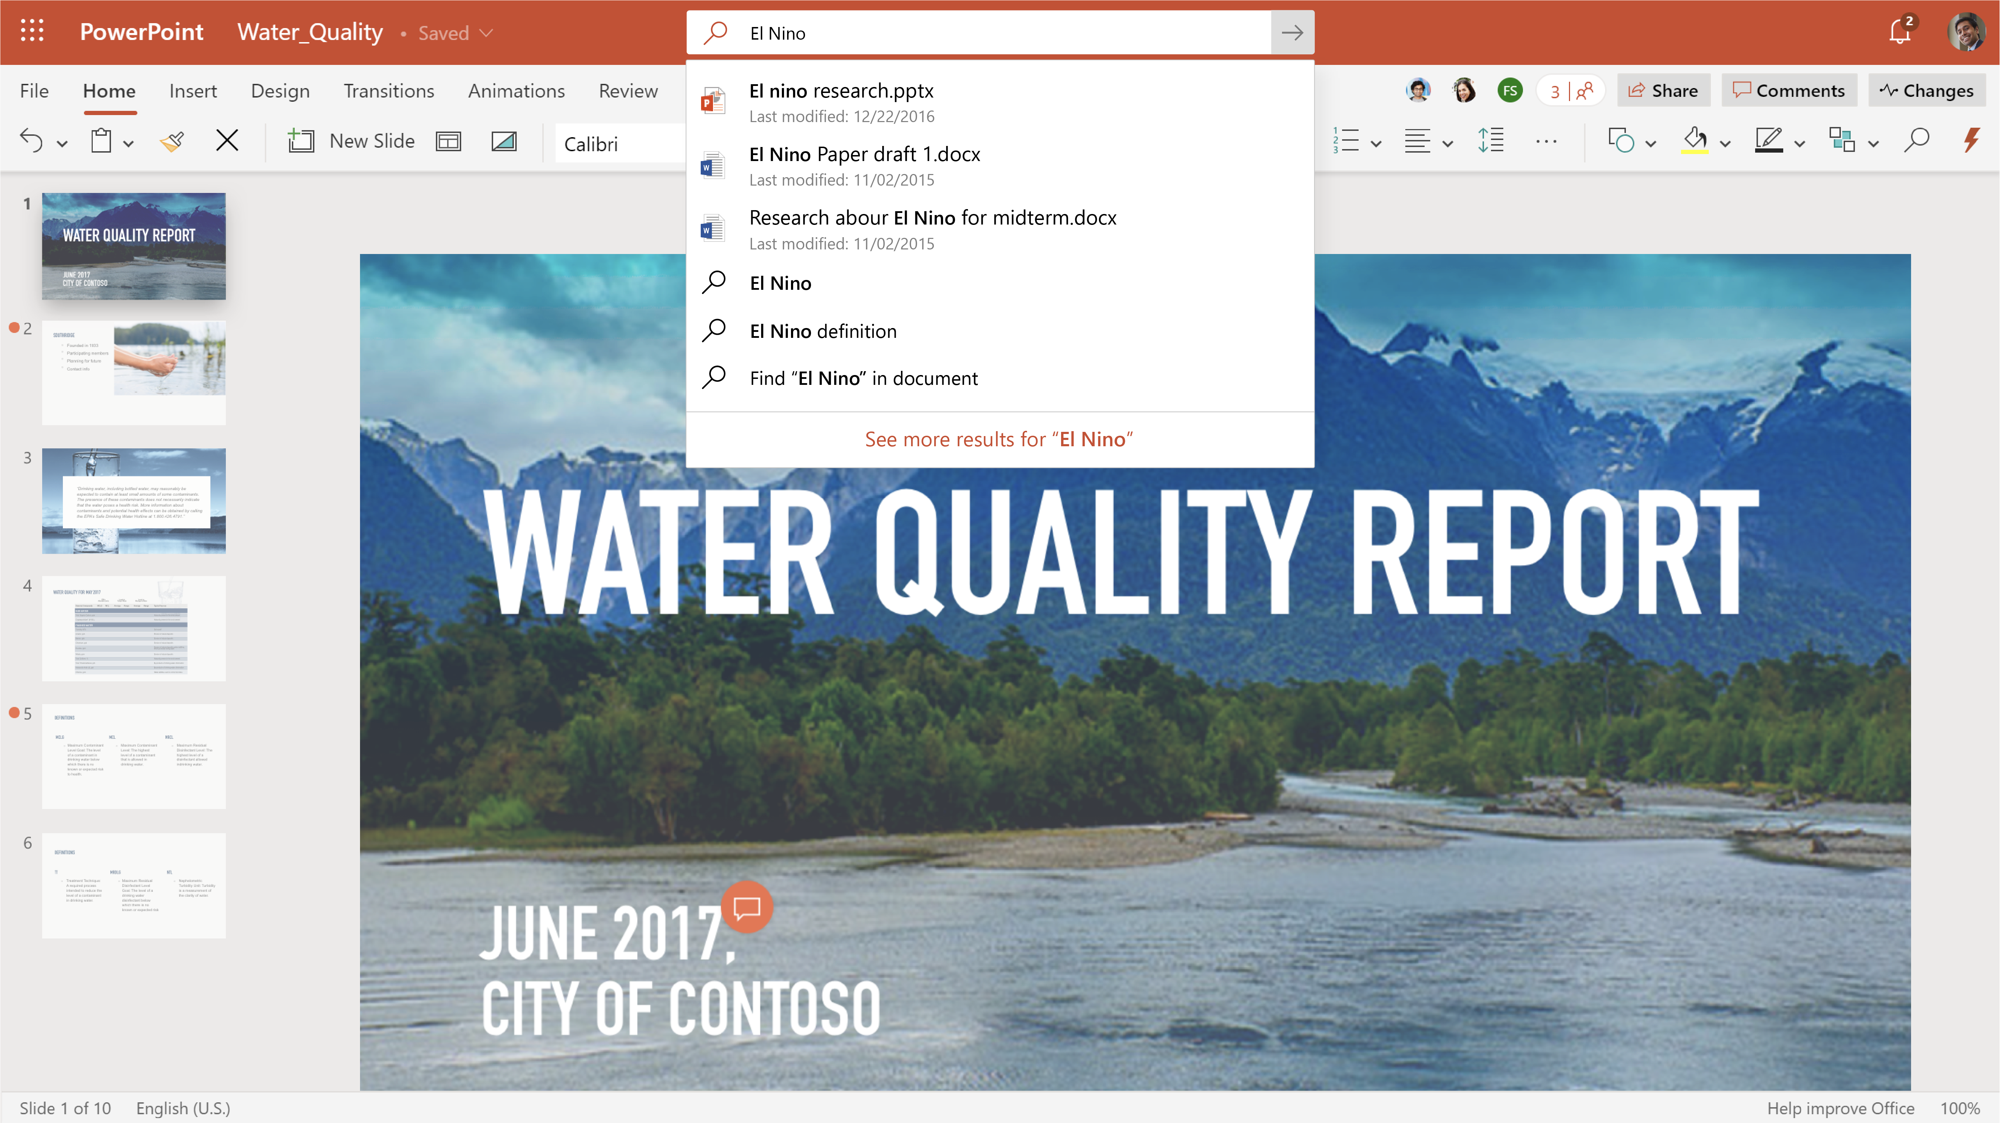
Notes:
For now, you just need to know that you can search from all over. But how does that look from within SharePoint? Let’s see some real content.
Login to Grpah Project Dev space
Go to office .com
Search for Project and see apps plus the SP site
Search for Mark 8 and see contents in files as well as the site itself
Click on view all results. Note the extra items like News. Extend the news to see intro.
Note pagination – third page has a PDF
Filters – filter by some date ranges
Note the verticals, selecting files and then news.
Then flip to People and see no-one there. Search for John and find the name
Search for marketing and see the people with marketing in their title, projects, skills etc
Flip back to the All vertical and see the people cards
Note the filters have expanded based on the content there
Note some of the PowerPoints showing real content

Slide 8
Microsoft Search vs SharePoint Search
Notes:
So what about SharePoint? Flip over to SharePoint
Search again for Mark 8
Compare with Office.com searching for Mark 8
Strange that some of the icons different
Otherwise the same. See I told you
Click on the Mark 8 Project Site
Look at the top – search this site
Search for Mark 8 – note all the results in this site. Click on Organisation – see results outside of the site
Click on Exit Search and then click on Documents
Note that it says Search This Library. Awesome, easy hidden stuff.
Click expand to search all items in this site.
Scroll to the bottom and see Classic Search Results
Take out the pages in the link if it doesn’t work and mutter about stupid things changing
Compare differences. Looks classic. But more filters. Looks worse but can change things.

Slide 9
IS THAT IT?
Erm
Not much has changed
Notes:
OK, so many of you may be thinking at this point that not much has really changed. Especially from the SharePoint side, it does feel much the same if I am brutally honest. But there is more. I mean it’s Modern right? Actually, there is more than that. Let’s take a look at the search centre.
Go to the admin centre and look under settings
Look at acronyms and add one – NSFW — Neglected to Save File in Word
Look at bookmarks and add one – mcd79 to https://www.mcd79.com
Look at locations
Look at Q&A
Go back and add a bookmark for leave. Add powerapp id 77c7a576-2113-4996-81b5-410ec9787bdc
Let’s try those out
search for collab365
Search for sevenoaks (may need cpsdemos for that)
Back to admin
Enable search in Bing under configuration
Go to bing.com
Search for collab365

Slide 10

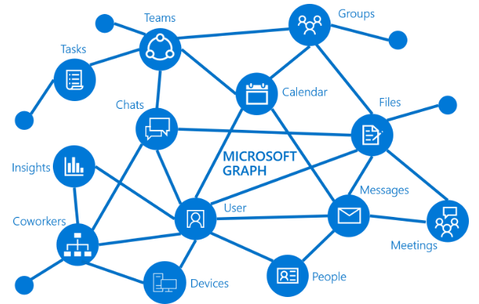



Connectors
Microsoft Graph
Notes:
The other key area is that the Microsoft Graph will now power extensions to your search. You can pull your own content in to Microsoft Search and add to your own area. I say that you can but, it’s still in preview. You can request to be on the preview, but I have to confess that I haven’t yet been admitted to this so what I will share now is from Ignite mostly.

Slide 11

Microsoft Graph Connectors (Preview)
{api}
Microsoft-built
connectors
Ecosystem Partner connectors
Microsoft Graph Search API
Notes:
There are three areas of the preview, the Microsoft built connectors, partner connectors and finally your own custom connectors.

Slide 12
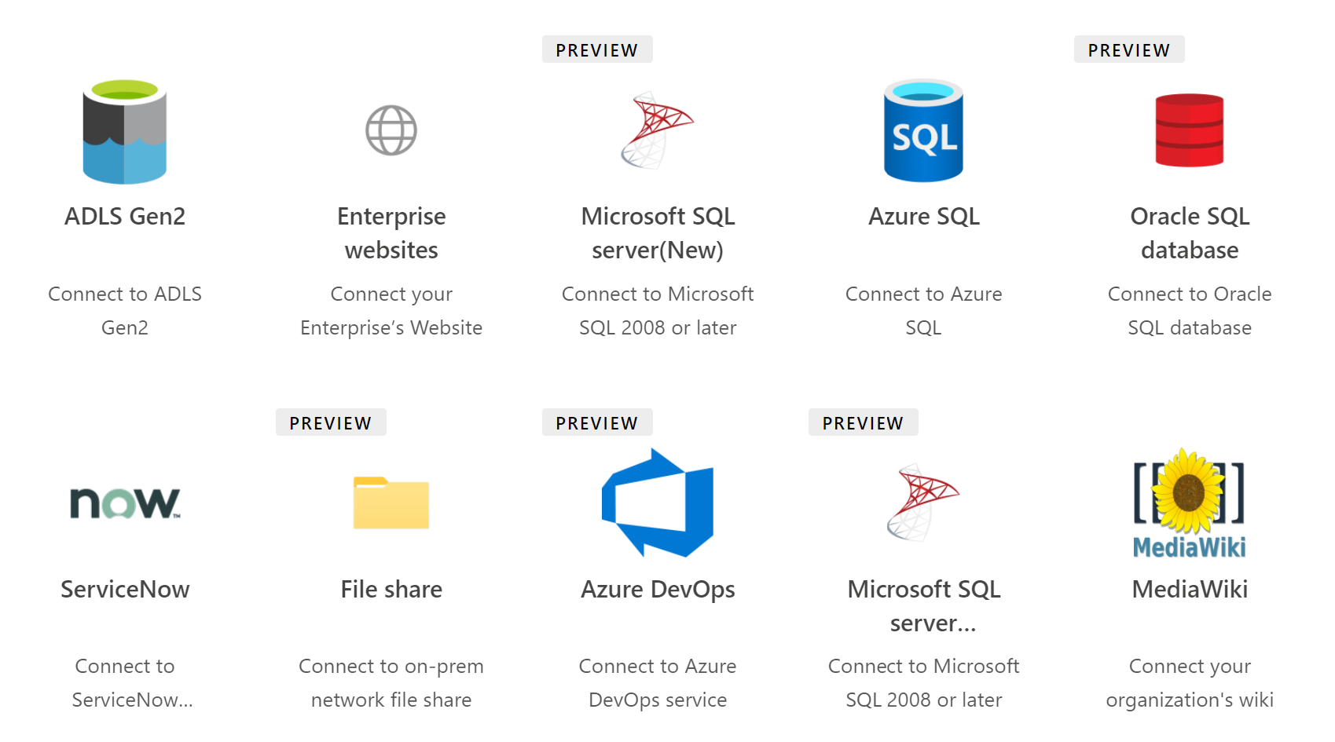
10 Microsoft-built Connectors (currently)
Notes:
Microsoft offers 10 connectors as part of the preview, allowing you to connect to some standard areas. Interestingly, while you would expect things like FileShares and possible even Data Lake, it also allows connections to custom databases with SQL, full websites, mediawiki and even ServiceNow, strengthening the partnership that Microsoft has with ServiceNow.

Slide 13
Partner Connectors
Aderant | Adobe Experience Manager | Alfresco | Alfresco Content Services | Amazon Aurora | Amazon RDS | Amazon S3 | Any SQL-based CRM system | Atlassian Confluence
Atlassian Confluence Cloud | Atlassian Jira | Azure Blob Storage | Azure Data Lake | Azure Event Hub | Azure SQL Database | Deltek | Documentum | Documentum DQL
EMC eRoom | Elastic | Elite / 3E | e-Spirit FirstSpirit | Exchange | FTP | Facebook Workplace | File Share | File System
GitLab | Google Cloud SQL | Google Docs | HDFS | HP Consolidated Archive (EAS) | Hbase | IBM Connections | IBM Connections Cloud | IBM Content Manager
IBM Db2 | IBM FileNet P8 | IBM Lotus Notes | IBM Notes | IBM WebSphere | iManage Work | JIVE | Kafka | Kinesis
LegalKEY | LDAP | LexisNexis InterAction | Lotus Notes | Lotus Notes Database | MediaPlatform PrimeTime | MediaWiki | Micro Focus Content Manager | Microsoft Azure AD
Microsoft SQL Database | Microsoft SQL Server | Microsoft SharePoint | Microsoft Windows File Server | Microsoft Yammer | MySQL | NetDocuments | Nuxeo | Objective
Microsoft OneDrive | OpenText Content Server | OpenText Documentum | OpenText Livelink/RM | OpenText eDOCS DM | Oracle Database | Oracle Knowledge Advanced Cloud | Oracle WebCenter | Oracle WebCenter Content
Pironet NDH | Pirobase CMS | PostgreSQL | RDBMS Server | RSS | Relational databases | SAP ERP | SAP HANA | SAP NetWeaver Portal
SAP PLM DMS | SMB | SMB File Share | SMTP | SharePoint 2013 | SharePoint 2016 | SharePoint Online | Sitecore | StageR
Symantec Enterprise Vault | TeamForge | Twitter | Veeva Vault | Veritas Enterprise Vault | Web Crawler | Windream ECM-System | Workplace by Facebook | Xerox DocuShare
Over 100 connectors
https://docs.microsoft.com/en-us/microsoftsearch/connectors-gallery#Partners
Notes:
If those don’t meet your needs, you can use some pre-built connectors from several Microsoft partners. These are likely to incur some costs but will reduce the effort needed to get started with some of these standard services like Salesforce, Twitter, and Lotus Notes. How much? You would need to check with the partners noted on the Microsoft Search Connectors page. There is also the option of building out your own connector.
Show some of the details at https://docs.microsoft.com/en-us/microsoftsearch/configure-connector

Slide 14

Demo
Notes:
Create Connector to Azure Dev Ops

Slide 15
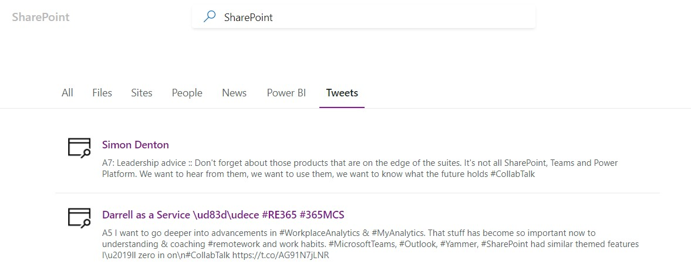
Custom Connectors Demo

Slide 16
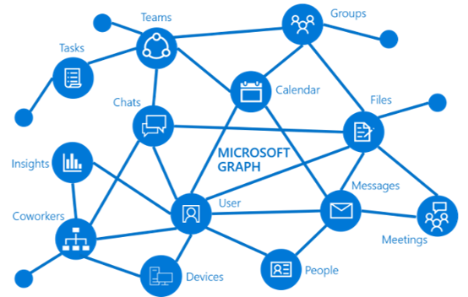
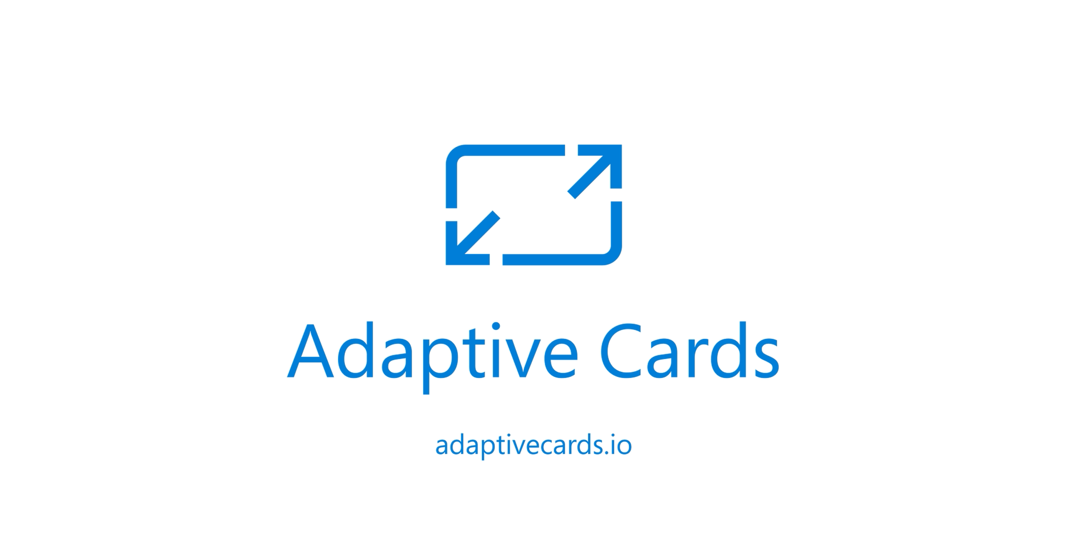
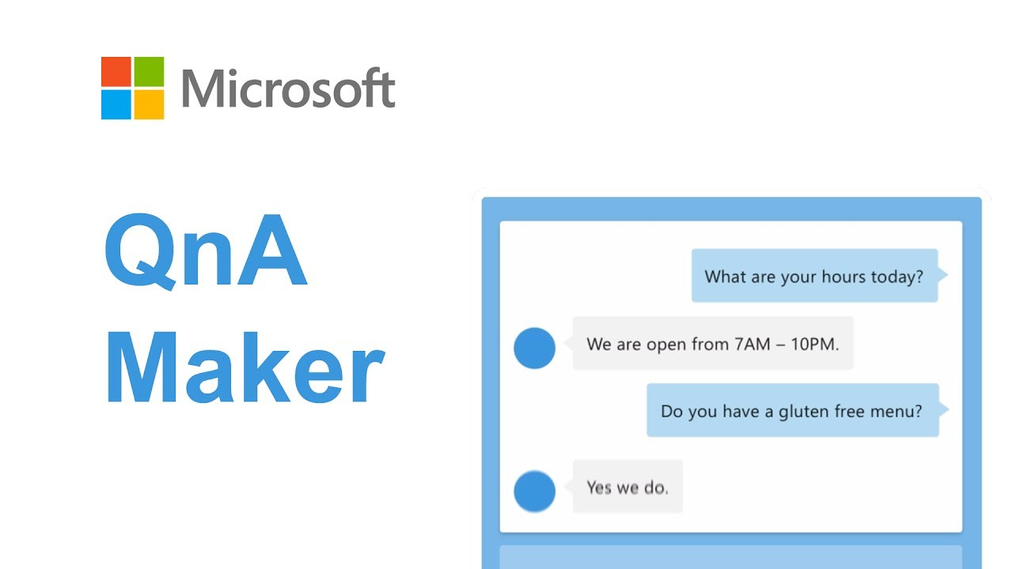
Developing with Microsoft Search
Microsoft Graph
Adaptive Cards
QNA Maker
https://github.com/kevmcdonk/ms-search-spa
Notes:
So are you stuck with using all these great things to just being in Microsoft 365? What about custom apps? The answer is you can still access Microsoft Search through an API and naturally, [click] the Microsoft Graph is the place to do it. It provides interfaces for Search to get back results from one call. Let’s have a look at the graph explorer.
Show the search results in graph explorer/
[click]
The results can then be rendered with adaptive cards and you can have a card for each different result type to really get what you need. Using the templating, you can pass on the properties nicely and have the results show not only in your own app but potentially in search from Microsoft 365 as well.
One thing that you can’t yet do is to return the QNA and other custom areas that I talked about earlier. For a solution I needed to create on this, I instead used the QnA Maker to set up a few known results. This was pulled together on the ms-search-spa app that is available on my Github profile. Here’s an example.

Slide 17




What does the future hold?
PEOPLE, SKILLS AND MORE CONTENT
Wider availability for external connectors
MORE HUBS
VIVA TOPICS AKA Project Cortex
https://techcommunity.microsoft.com/t5/microsoft-search-blog/what-s-new-for-microsoft-search-ignite-2020-edition/ba-p/1675291
Notes:
People search was announced at Ignite and will allow you to search for a person and then search for content connected to them – find documents that they have worked on but also content connected to them. Linked to this will be improved skills and expertise with it not only allowing users to self-attest but have AI driven recommendations based on content created.
There will also be more content with Power BI, Conversations (including email, teams chat and yammer)
Soon the external connectors should be out of preview and more will become available for people to use.
There will be more Hubs to start searching in with Teams search due to be powered by Microsoft Search and also more intelligence search in Outlook Mobile, including voice powered search. Desktop search shouldn’t be far behind either. More admin capabilities are coming including improvements to the recommendations for the answers.
The most exciting news though is Project Cortex. It’s not specifically Microsoft Search but it will make use of the same data to make it simpler to find data. Topic search
Where Microsoft Search focuses currently on using search boxes, Project Cortex surfaces more of that data through linked meta data and Knowledge Hubs. But Cortex is a whollllleee session in itself.

Slide 18
Summary
The what
The Why
The How
Search across Microsoft 365 content and your own using Microsoft Graph with AI
One place and one way to get your search contents from across everything
Access from Search Box, results from configuration, develop with Microsoft Graph
Notes:
So what is Microsoft Search? It’s the engine that will power search across the whole of Microsoft 365, allowing consistent searches with permissions and scheduling all managed centrally.
Why would you use it? Well, so you have just one way on searching that content, instead of having different formats for each different search service like Windows and Office. Add your own results as well with FAQs, Bookmarks and Apps among other things.
How do you use it? For the most part, just use that search box now. Some elements like Teams aren’t quite onboard yet but soon you will see that same experience everywhere. Not only via the searchbox though but also via the API. One way of accessing, one way to use search results. Formatting can even be consistent with adaptive cards as well.
So get using Microsoft Search and hopefully now you have a good idea on how to get started.

